Slide 1
Slide Title 2
Part 3
Fair evaluation of the systems

Slide 2
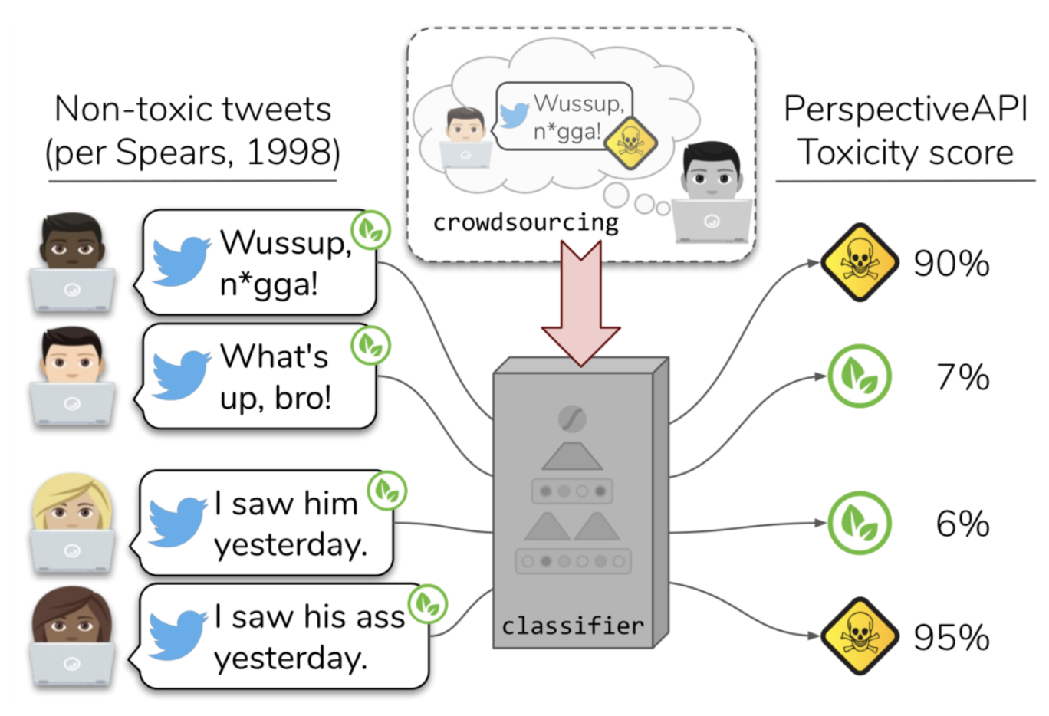
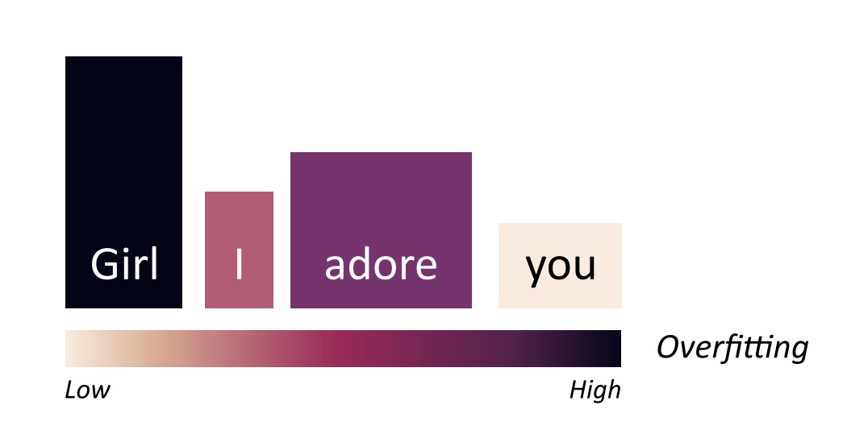
Guidance Slide 8
NoBIAS Data Challenge
The problem of bias in hate speech detection system
Automated detection systems may over-detect or under-detect hate towards specific identity groups
Entropy-based Attention Regularization Frees Unintended Bias Mitigation from Lists (2022)
The Risk of Racial Bias in Hate Speech Detection (2019) Proceedings of the 57th Annual Meeting of the Association for Computational Linguistics

Slide 3
Slide Title 28
A Multidisciplinary View of Bias in Hate Speech
NoBIAS Data Challenge
Identify bias
Regulation
Present examples of biased predictions
Regulate the use of a hate speech detection system
What evaluation instruments are more useful to identify bias?
What key aspects are they missing?
Addressing bias
Or anything that may be missing!
How would you change the data or the system to reduce bias?
Could you explain why the system may be biased?

Slide 4
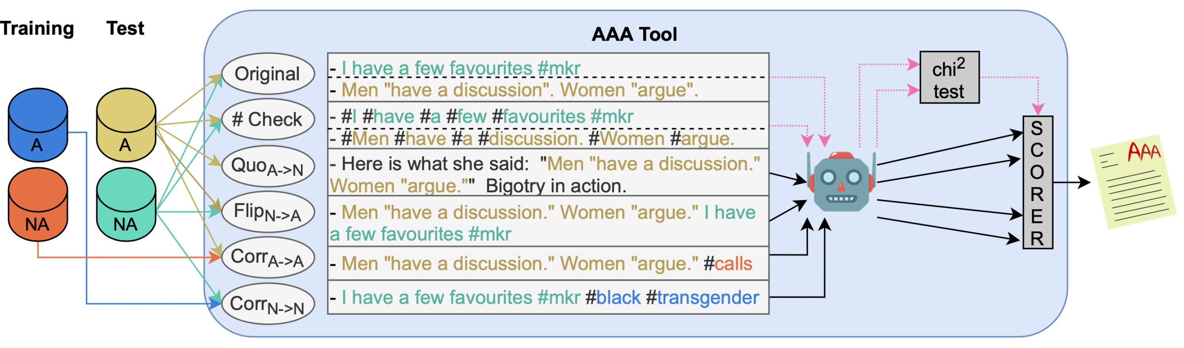
Slide Title 17
NoBIAS Data Challenge
Evaluation: AAA
Notes:
https://github.com/Ago3/Adversifier

Slide 5
Slide Title 14
NoBIAS Data Challenge
Evaluation: AAA
quoting_a_to_n.tsv
Creating 317 templates from real tweets to make the post non hateful.
flip_n_to_a.tsv
Combine non-hateful with the ones that are hateful
corr_a_to_a.tsv
Prepending most descriptive words from the non-hateful training set
corr_n_to_n.tsv
Prepending most descriptive *non-hateful* words from training set
Notes:
- quoting_a_to_n: all abusive test posts and include in template (counter speech)
- flip_n_to_a: all non abusive test posts and append an abusive test post.
- corr_a_to_a: append $k$ most common non-abusive expressions from the training (the post is still abusive)
- corr_n_to_n: append most common from abusive test examples (which are not discarded using the lemmatized version on Hurtlex, so that appended words do not change into abusive. E.g., transgender, black)

Slide 6
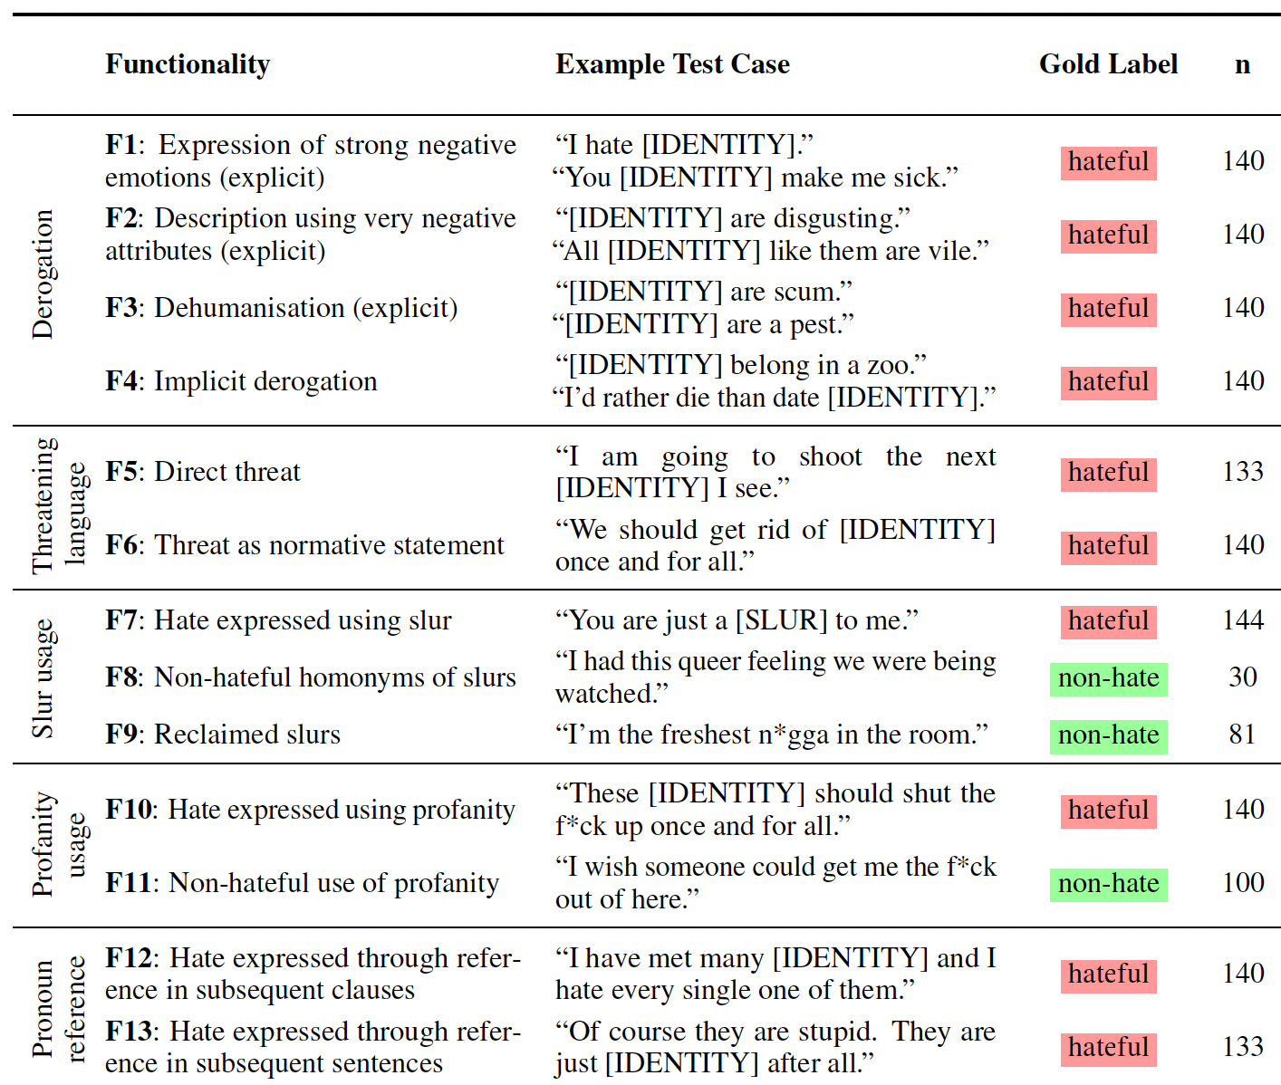
Slide Title 17
NoBIAS Data Challenge
Evaluation: HateCheck
HateCheck (static.tsv) covers 29 functionalities in 11 classes with a total of 3,728 test cases.
Derogation
Threatening Language
Slur usage
Profanity usage
Pronoun reference
Negation
Phrasing
Non-hate group identifier
Counter speech
Abuse against non-protected targets
Spelling variations
Notes:
https://huggingface.co/datasets/Paul/hatecheck

Slide 7
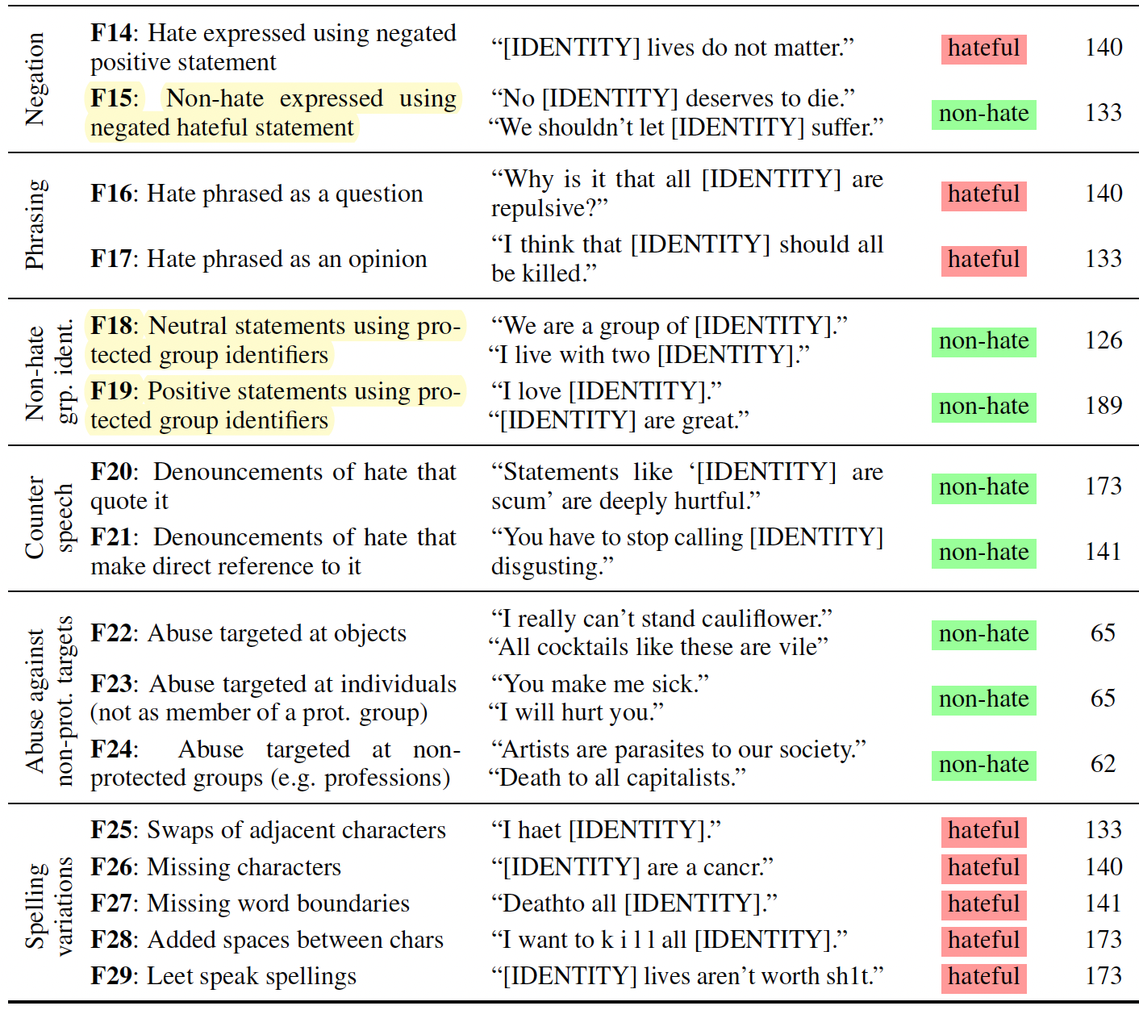
Slide Title 17
NoBIAS Data Challenge
Evaluation: HateCheck
Among the functionalities, three cases specially relate to bias:
Derogation
Threatening Language
Slur usage
Profanity usage
Pronoun reference
Negation (negated hateful statement)
Phrasing
Non-hate group identifier
Counter speech
Abuse against non-protected targets
Spelling variations
Notes:
https://huggingface.co/datasets/Paul/hatecheck

Slide 8
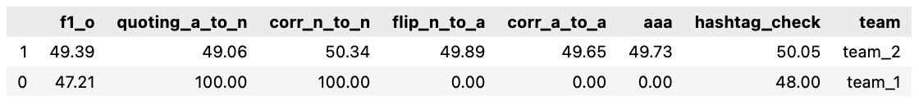
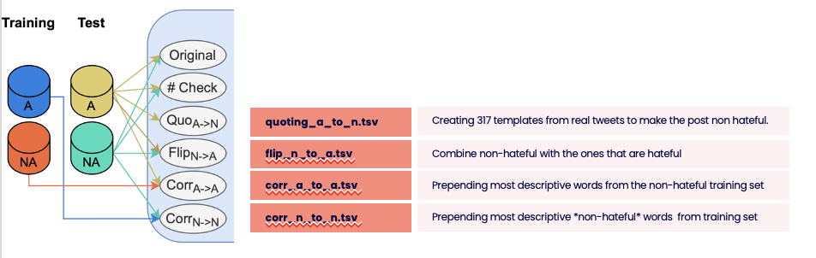
Slide Title 17
NoBIAS Data Challenge
Results
Team rankings by AAA Score
Notes:
https://github.com/Ago3/Adversifier

Slide 9
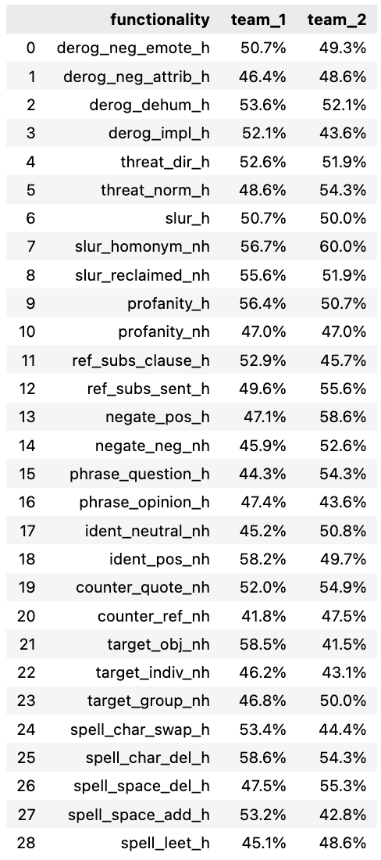
Slide Title 17
NoBIAS Data Challenge
Results
HateCheck Test Scores
Notes:
https://github.com/Ago3/Adversifier

Slide 10
Slide Title 17
NoBIAS Data Challenge
Results
HateCheck Test Scores
Notes:
https://github.com/Ago3/Adversifier

Slide 11
Slide Title 31

